Slide 1
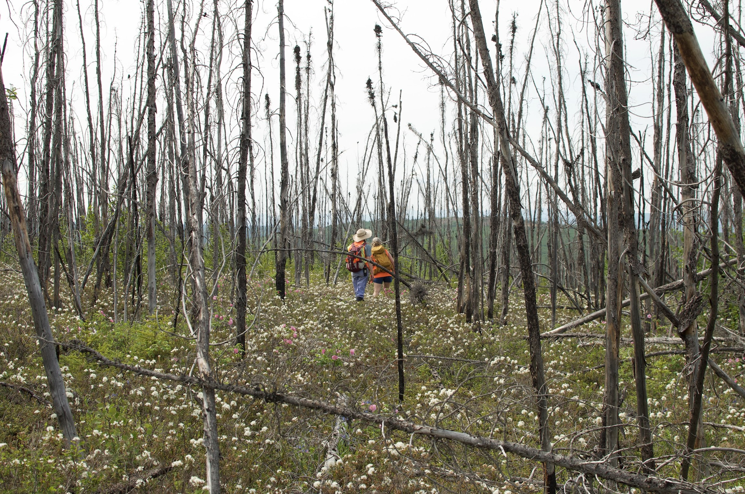
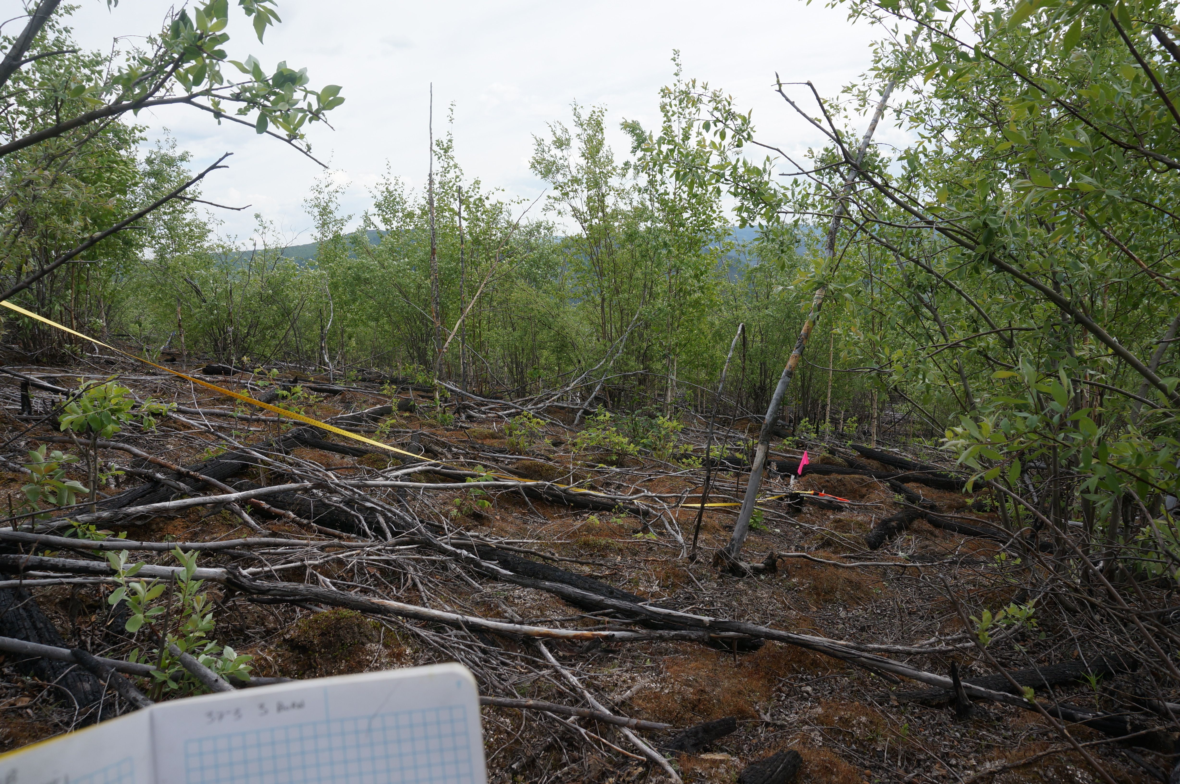
Once-burned landscape
Thrice-burned landscape
Average fuel
High fuel
Average fuel
High fuel
Moderate fire weather
Moderate fire weather
Moderate fire weather
Moderate fire weather
Average fuel
High fuel
Average fuel
High fuel
Extreme fire weather
Extreme fire weather
Extreme fire weather
Extreme fire weather

